Slide 1

Predicting Future Reliability
Twesigye John Davidson 2023/BSE/146/PS
Kagyezaho Eduardo 2023/BSE/046/PS
Okiror Mark Gregory 2023/BSE/130/PS
Nimusiima Alvin 2023/BSE/112/PS
Arimu Mariam 2023/BSE/021/PS
Software Testing & Reliability / SWE 3102

Slide 2
Introduction and Context
Setting the stage for reliability prediction

Slide 3
The Academic Information Management System (AIMS), deployed at Mbarara University of Science and Technology in 1996 to manage student records, has experienced recurring annual module failures attributed to inadequate developer support and limited pre-deployment testing. Using historical module failure data recorded from 1996 to 2025, this study aims to develop a predictive model to forecast AIMS’s percentage failure rates for the next ten years (2026–2035). The findings will guide university management in deciding whether to retain AIMS or invest in a new, home-built Student Information Management System (SIMS)
Problem Definition

Slide 4
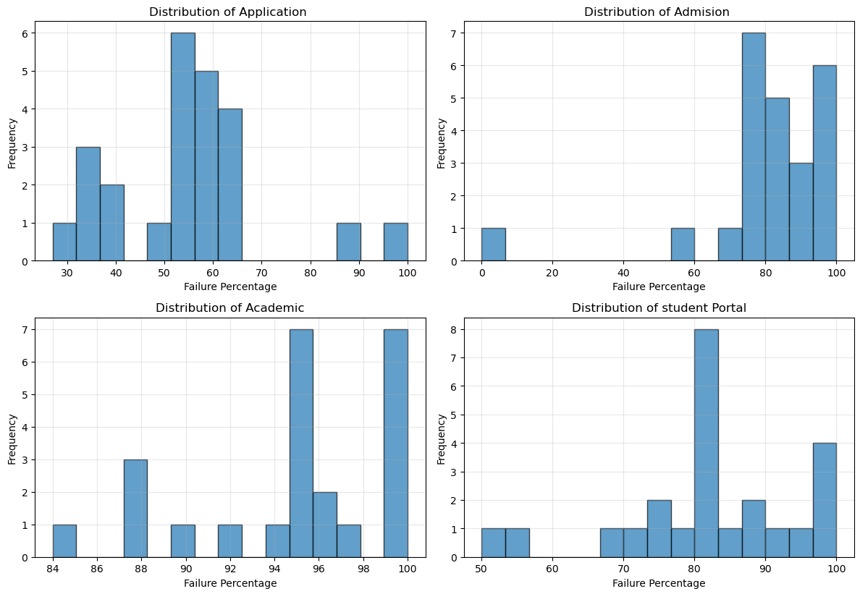
Target Variable Distribution
Exploratory Data Analysis

Slide 5
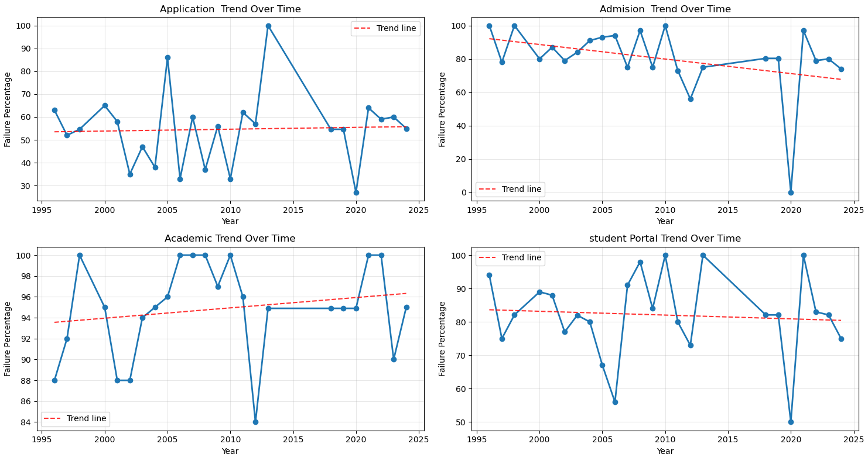
Time Trend Analysis
Exploratory Data Analysis

Slide 6
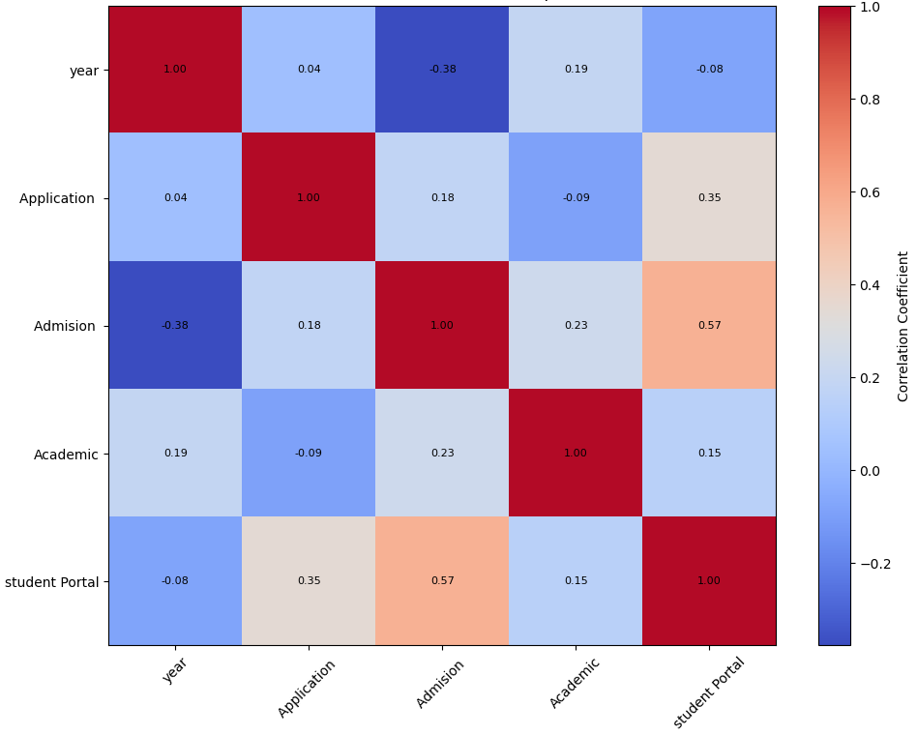
Correlation Matrix Heatmap
Exploratory Data Analysis

Slide 7
To address the challenge of forecasting AIMS reliability, we developed a predictive modeling approach using historical failure data (1996–2025). We began with a Linear Regression model to capture the long-term trend but found it inadequate for the system’s nonlinear behavior. We then applied an XGBoost regressor to better model local variations and complex failure patterns. However, recognizing XGBoost’s limitations in long-range extrapolation, we designed a hybrid model that blends both approaches using the formula:
blended_pred=α×xgb_pred+(1−α)×lin_pred
This hybrid model combines the trend stability of linear regression with the pattern flexibility of XGBoost, providing a more robust and defendable prediction of AIMS failure rates for the next decade (2026–2035)
Solution
α = alpha (model multiplier)

Slide 8
ML Algorithms Explored
Evaluating Techniques for Reliability Prediction

Slide 9



Linear Regression
Exploring Simplicity and Interpretability
Initial Choice
Strengths
Limitations
The linear regression approach was chosen for its simplicity, making it easy to communicate insights to stakeholders while establishing a baseline for future comparison with more complex models.
Its strengths lie in straightforward interpretability and ease of explanation, allowing decision-makers to grasp essential trends in historical data without getting bogged down by complexity.
However, the method's limitations include a tendency to overlook nonlinear relationships, which can lead to inaccurate predictions, especially when dealing with more complex datasets over time.

Slide 10

XGBoost Approach
Exploring Nonlinear Modeling Capabilities
Motivation
Strengths
Limitations
The need for enhanced accuracy led to exploring XGBoost, which accommodates complex patterns in the data, improving prediction capabilities for module failures significantly over linear methods.
XGBoost excels at handling intricate relationships within large datasets, providing higher accuracy than simpler models while effectively managing overfitting through built-in regularization techniques and feature importance evaluations.
However, XGBoost struggles with extrapolation beyond the training data range, which can lead to unreliable predictions for future years if not carefully monitored during model deployment.

Slide 11
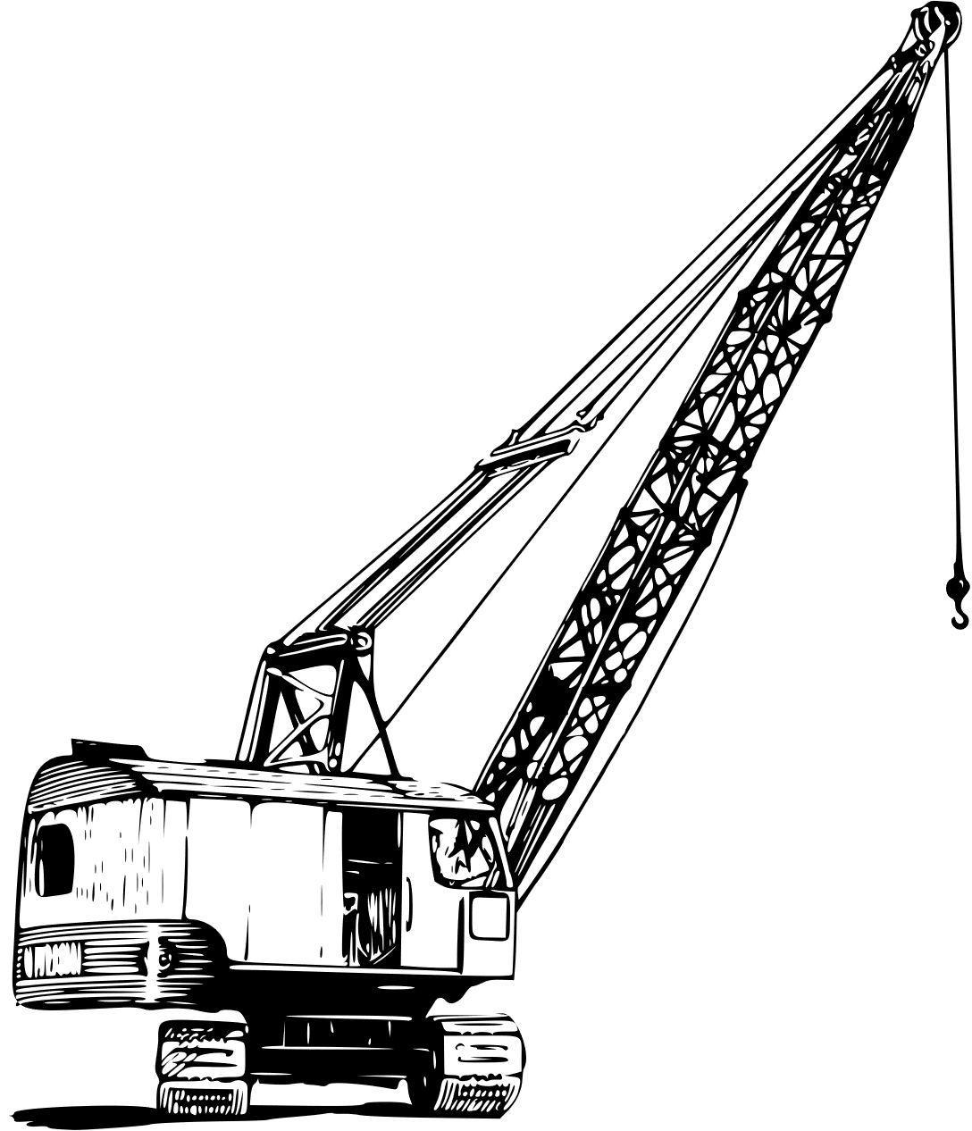

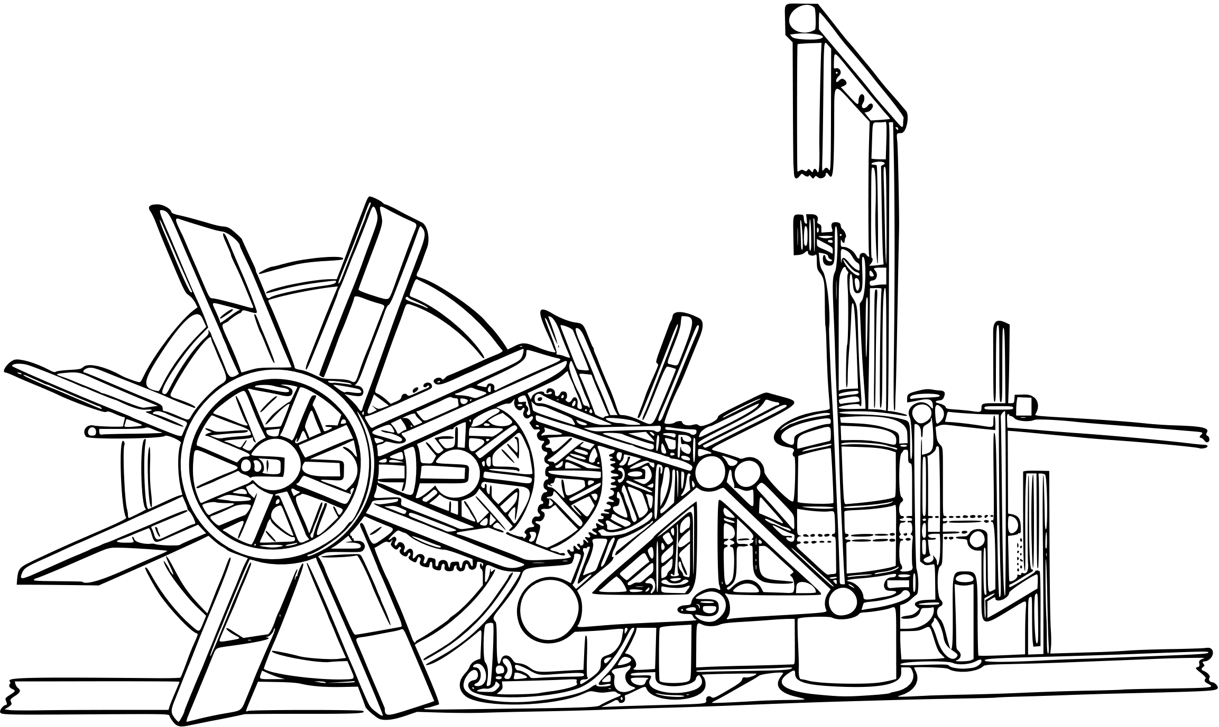
Hybrid Model Design
Balancing Extrapolation with Accuracy
Linear Regression
XGBoost Method
Hybrid Approach
The linear regression approach is favored for its simplicity and interpretability, providing a solid baseline model that is easy for stakeholders to understand and communicate.
The XGBoost approach allows for exploration of nonlinear patterns, enhancing accuracy while accommodating complex relationships in historical data, essential for reliable predictions moving forward.
The hybrid model combines linear regression with XGBoost, optimizing extrapolation and flexibility, thereby achieving a balanced forecast that is both interpretable and robust against varying data trends.

Slide 12
Model Evaluation
Visualizing Performance and Predictions of Models

Slide 13
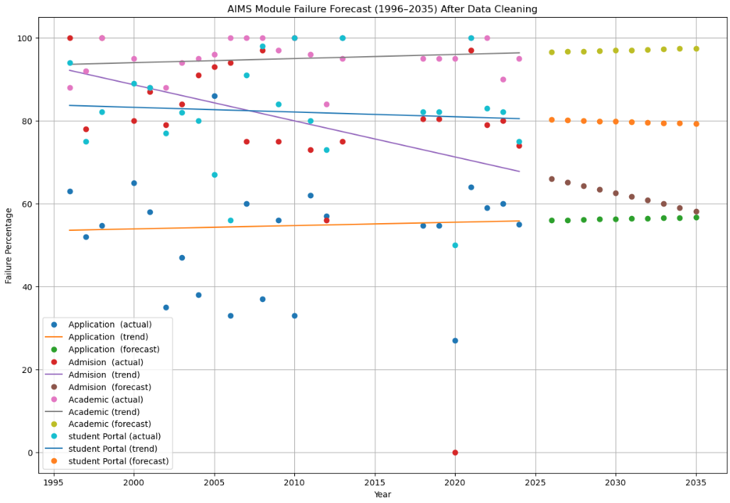
Linear Regression
Linear Regression Trend Ananlysis

Slide 14
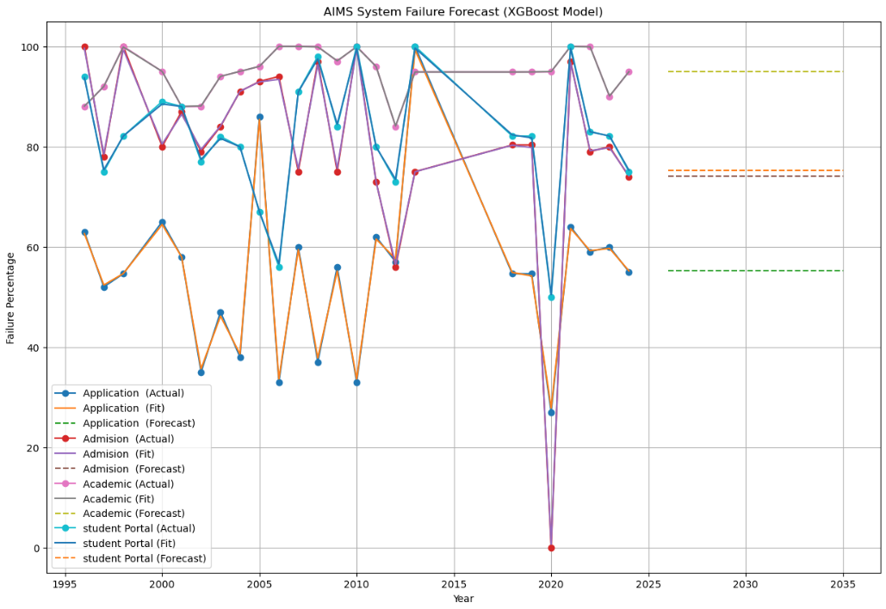
XGBoost Approach
XGBoost Trend Analysis

Slide 15
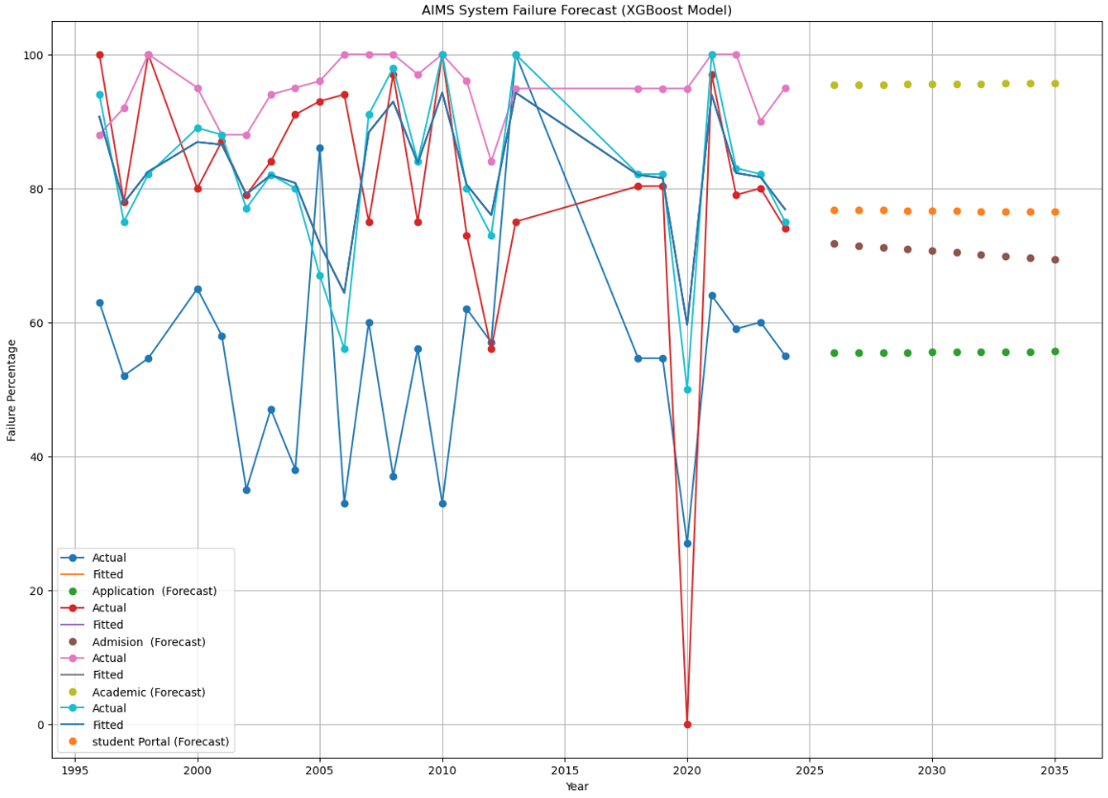
Hybrid Model Design
Hybrid Model Trend Analysis

Slide 16
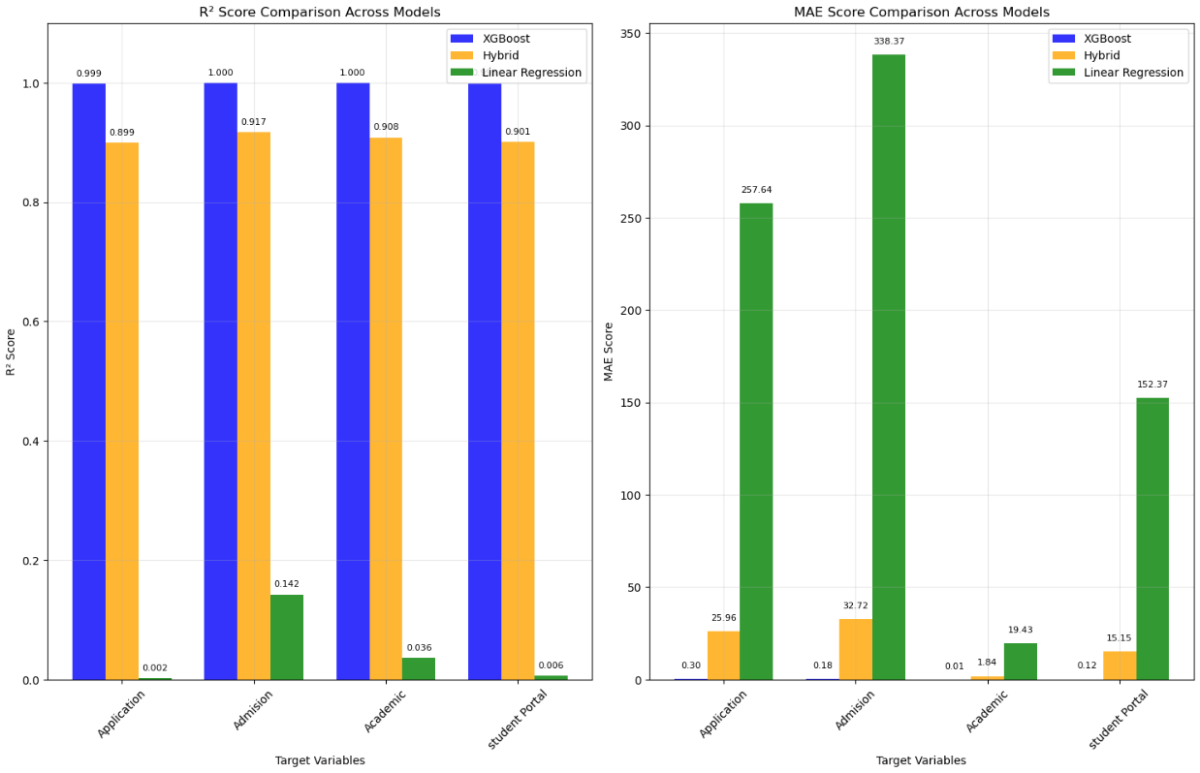
R² & MAE Scores

Slide 17
In this study, we analyzed the reliability trend of the Academic Information Management System (AIMS) at Mbarara University using historical failure data from 1996 to 2025. Our goal was to forecast future system performance and guide management on whether to retain or replace AIMS.
We explored multiple modeling approaches—beginning with Linear Regression for its interpretability, then advancing to XGBoost to handle nonlinear patterns. Recognizing the strengths and weaknesses of each, we designed a Hybrid Model that blends both methods to achieve balance between trend extrapolation and pattern sensitivity.
The resulting model provides a more robust and defendable prediction of future module failure rates (2026–2035), offering data-driven insight to support informed decision-making about AIMS’s sustainability and the potential transition to SIMS.
Recap

Slide 18

Thank You
We appreciate your attention and now you can ask questions.

